Slide 1
For Loop
https://www.youtube.com/watch?v=kKonIb8SDoM

Slide 2
a) For Loop : Basic

Slide 3
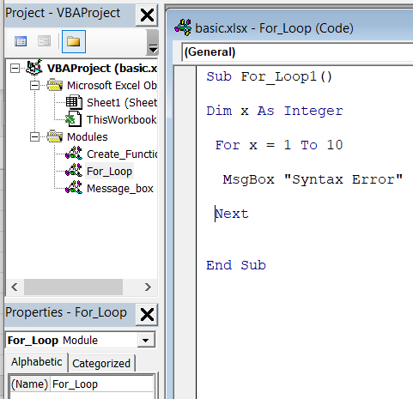
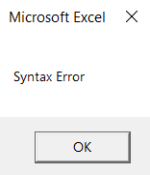
Sub For_Loop1()
Dim x As Integer
For x = 1 To 10
MsgBox "Syntax Error"
Next
End Sub
This message displays 10 times

Slide 4
b) For Loop : Debug / Add Watch

Slide 5
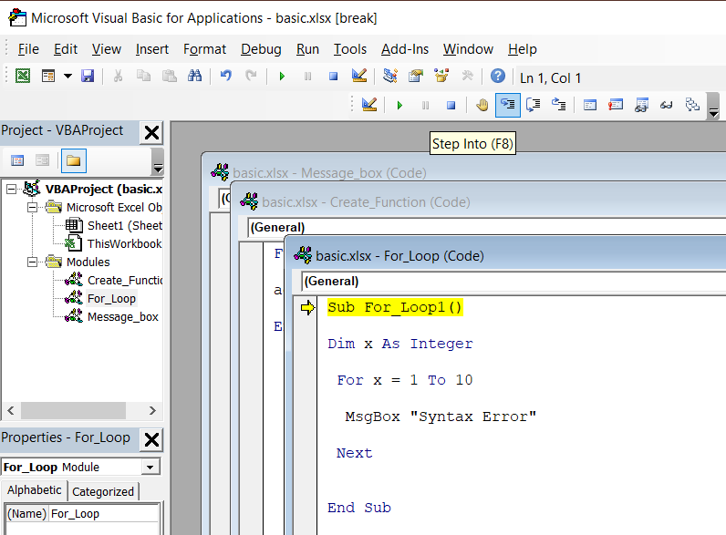
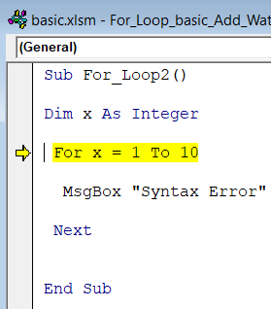
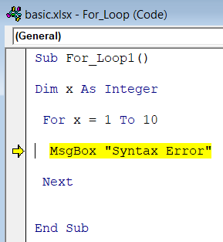
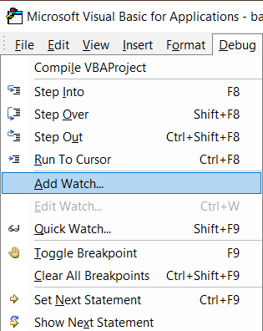
1
2
3
4

Slide 6
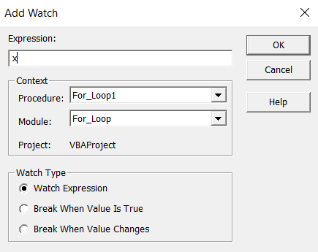
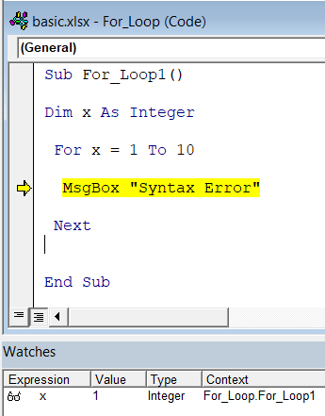
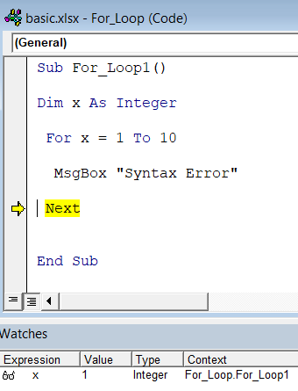

Slide 7
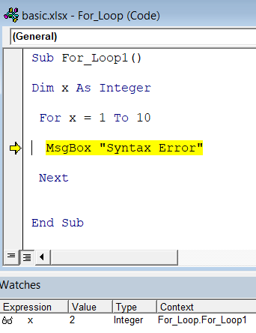
This repeats 10 times

Slide 8
c) For Loop : Debug / Add Watch
MsgBox x

Slide 9
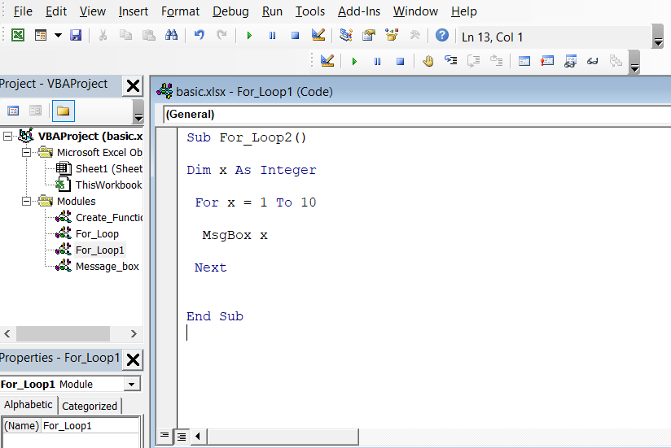
Sub For_Loop1()
Dim x As Integer
For x = 1 To 10
MsgBox x
Next
End Sub

Slide 10
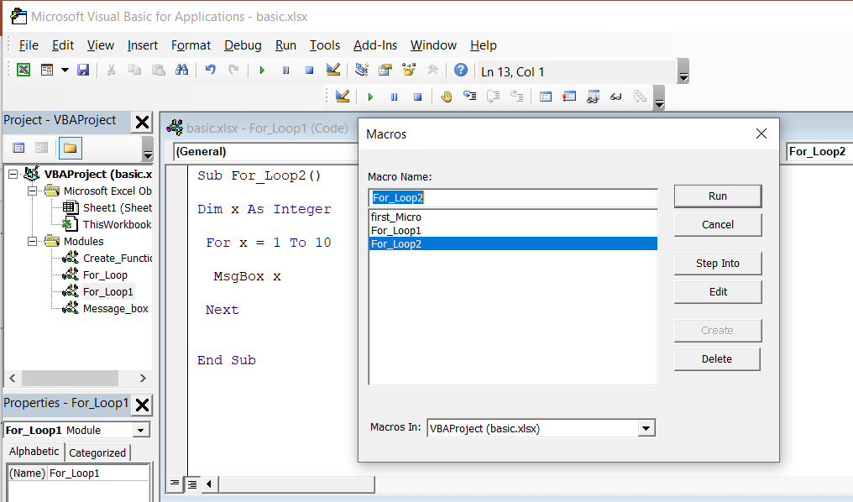
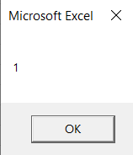
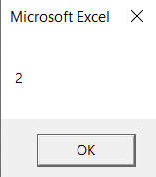
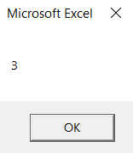
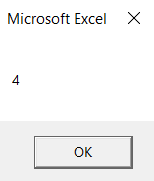
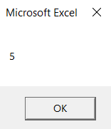
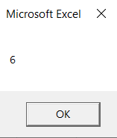

Slide 11
Sub For_Loop1()
Dim x As Integer
For x = 1 To 10
MsgBox "Syntax Error"
Next
End Sub
Sub For_Loop1()
Dim x As Integer
For x = 1 To 10
MsgBox x
Next
End Sub
Sub For_Loop1()
Dim x As Integer
For x = 1 To 10 Step 2
MsgBox x
Next
End Sub
Sub For_Loop1()
Dim x As Integer
For x = 1 To 10 Step 3
MsgBox x
Next
End Sub

Slide 12
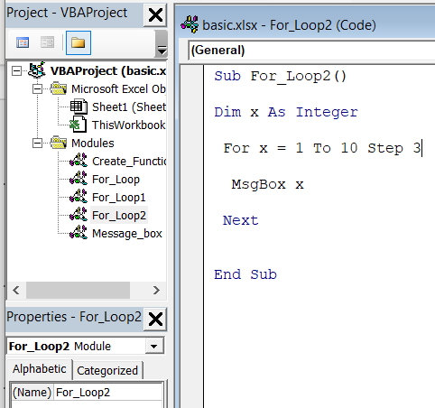
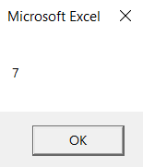
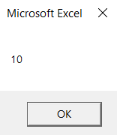

Slide 13
d) For Loop : Cells

Slide 14
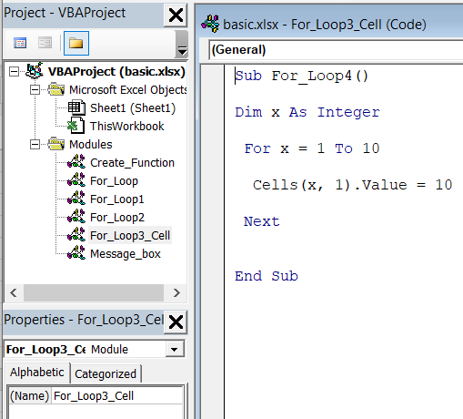
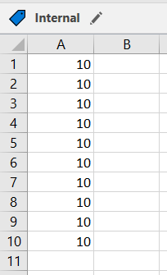

Slide 15
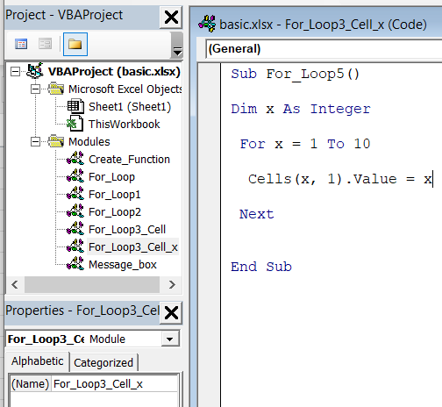
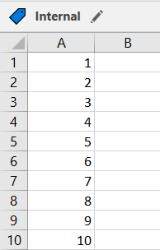

Slide 16
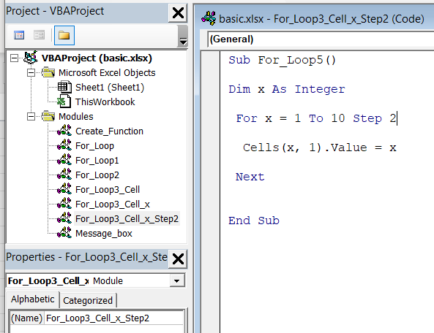
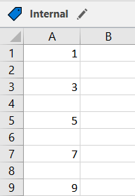

Slide 17
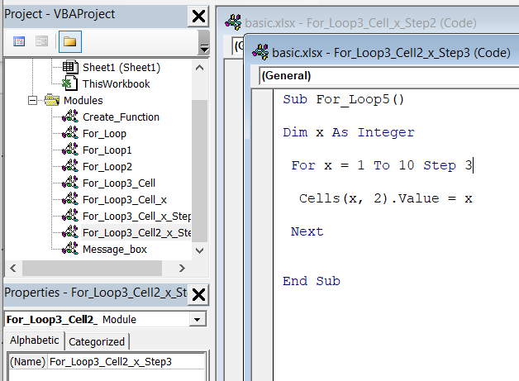
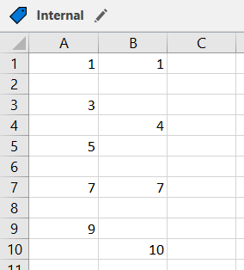

Slide 18
e) For Loop : Cells Color

Slide 19
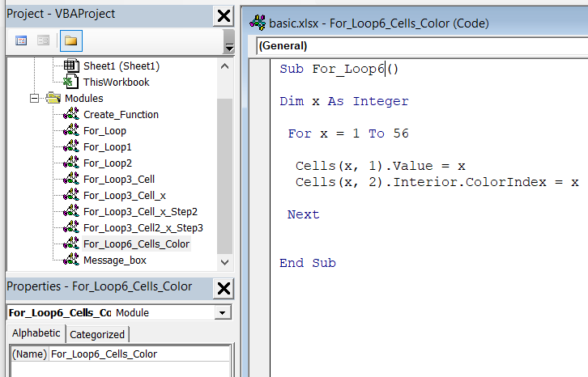
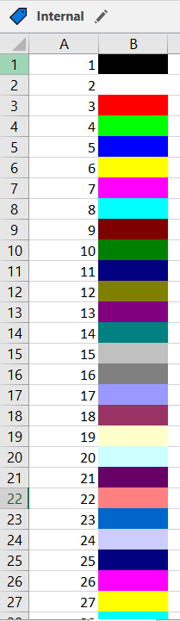

Slide 20
f) For Loop : Cells Color

